Slide 1


ORACLE
Account Receivables Operations and Financial Reporting in Oracle ERP

Slide 2

Created By:
Mohamed Adel Sayed Mohamed
Omar Mamdouh Ali hassanein
Aya mohamed elsayed elmasry
Hager Ayman Ahmed Eldoushe
Abrar Essam Mahmoud Mohammed
Fatma Alzahraa Hassan Mohamed Abo Bakr

Slide 4
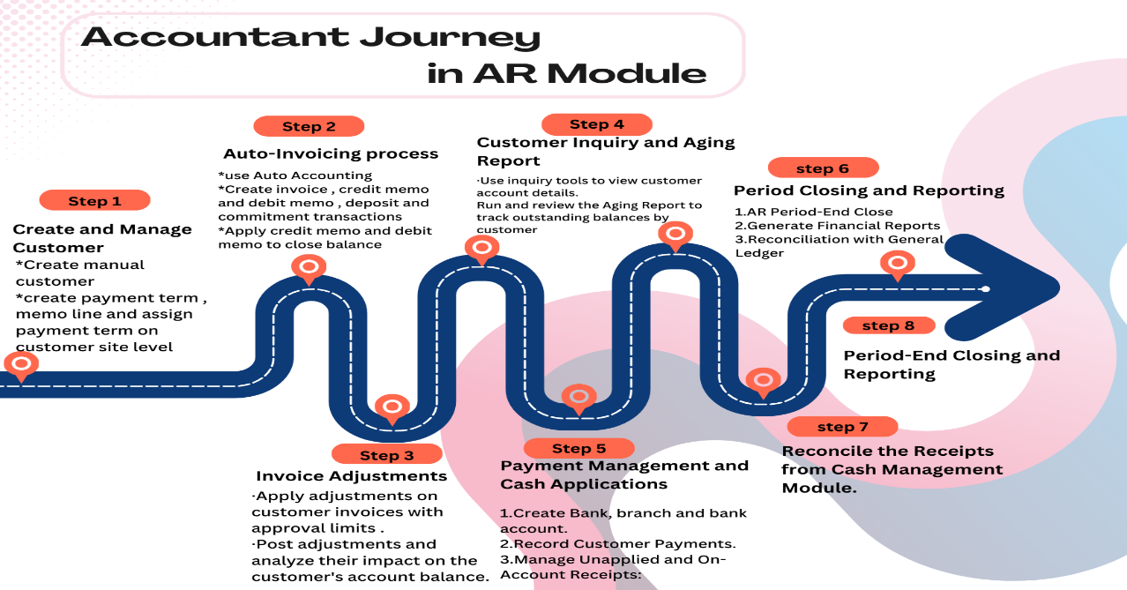

Slide 5
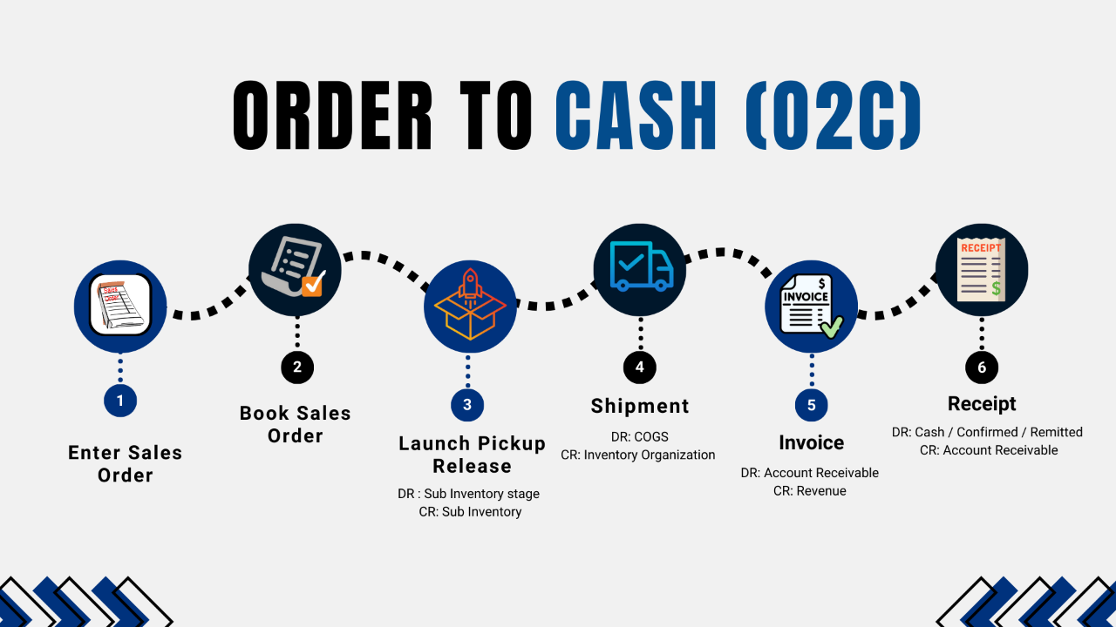

Slide 6
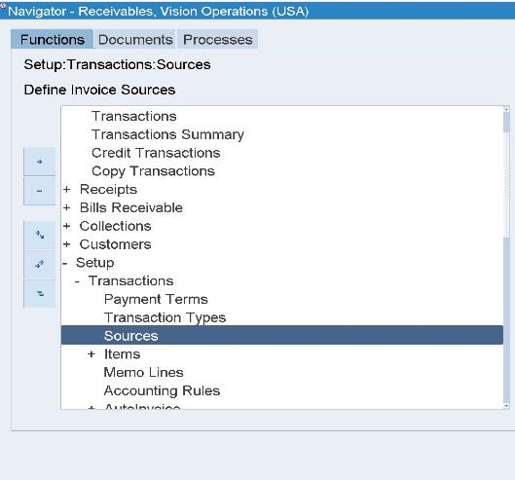
source
Source : Refers to the origin or type of Transactions that is being Imported or Entered Into the system, It helps to Identify and categorize transactions for tracking, Re-Porting and Processing Purposes.
Purpose of a Source:
Transaction Identification: Defines the nature or origin of transactions, such as manual invoices, receipts, or transactions imported from external systems.
Control: Specifies rules and settings for data entry, ensuring consistency and accuracy.
Audit and Reporting: Helps in identifying and separating transactions by their origin during audits or analysis.
To access source within the Accounts Receivable(AR) module
Setup > Transactions > Sources

Slide 7
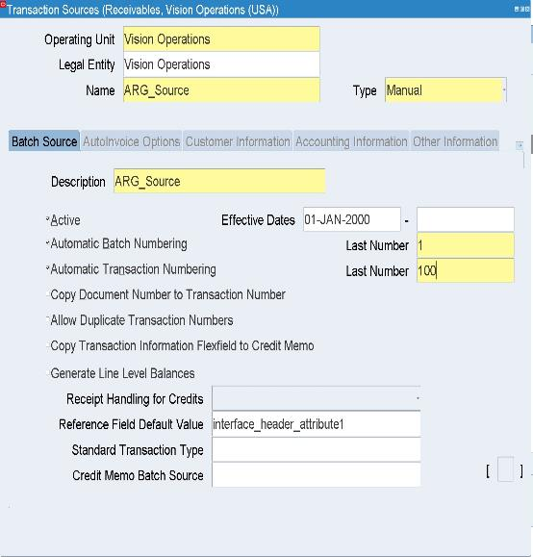
Transaction Source
Operating Unit (OU): is a business entity or division within a company that represents a level of control for operations and transactions.
Legal Entity: is a recognized legal organization that has the right to own property.
Types of Sources
Manual Sources: Transactions Entered Manually into oracle ERP (Invoices, Credit memo)
Imported Sources: Transactions imported through External Systems often using tools Like oracle Auto Invoicing.
Active : Indicates whether the Source is Currently enabled or available for use In the system.
Automatic Batch Numbering: this Setting allows oracle ERP to assign unique batch numbers automatically When Creating a Batch of transaction.
Automatic Transaction Numbering: This setting Enable oracle ERP to Generate unique transactions numbers Automatically for Individual transactions within a Batch.

Slide 8
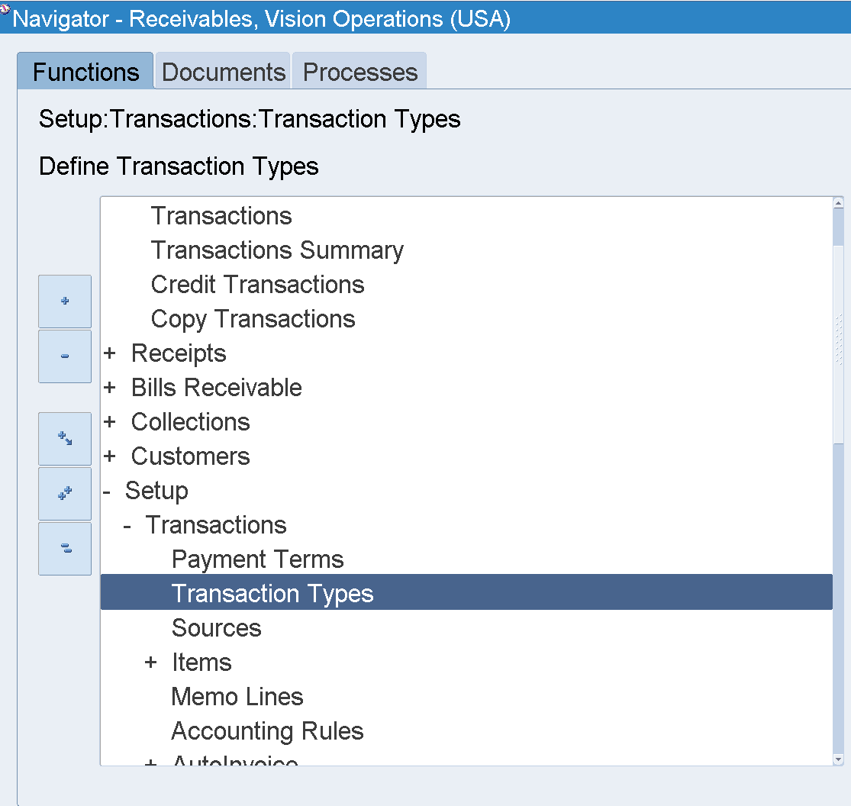
Transaction Types
Transaction types: are used to define the nature of the transactions that occur within the system. Each transaction type governs how the system processes different types of accounting and business events, such as invoices, credit memos, and receipts.
To access transaction types source within the Accounts Receivable(AR) module
Setup > Transactions > Transaction types

Slide 9
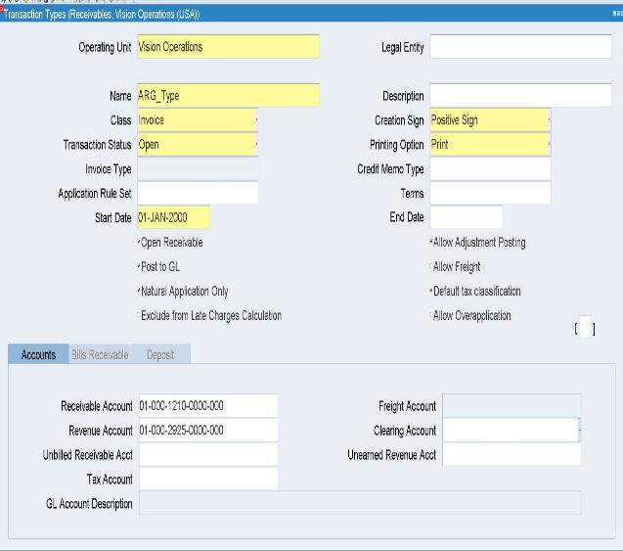
Transaction Types
First, we enter operating Unit
Second, we choose a name for Transaction Type
Then:
Class: define the category or type of a transaction. They determine the business behavior, rules, and accounting entries associated with different types of transactions.
Common Transaction Types in AR (Transaction Class)
Invoice: For recording customer sales or service charges
Debit Memo: Used to increase the amount a customer owes.
Credit Memo: Used to reduce the amount a customer owes or correct billing errors.
Chargeback: Created when a customer disputes an invoice or makes a partial payment, generating a new receivable for the disputed amount.
Deposit: An upfront payment from a customer that will be applied against future invoices.
Guarantee: A form of agreement where the customer guarantees future payments.

Slide 10
Transaction Types
Transaction Status: The transaction status indicates the current state of the transaction in Oracle AR.
Common Statuses
Open: The transaction has been created but has not yet been completed or fully processed.
Closed: The transaction has been fully processed, and no further changes can be made.
Pending: The transaction is waiting for action, such as approval or further processing.
Creation Sign: The creation sign determines whether the transaction amount is positive or negative when it’s created. It essentially defines the direction of the transaction.
Possible Values
Positive: The amount is positive (e.g., for an invoice or receipt).
Negative: The amount is negative (e.g., for a credit memo or debit memo).

Slide 11
Transaction Types
Printing Options: Printing options specify how and when the transaction documents, like invoices or credit memos, should be printed or processed.
Options
Print : The document is printed as soon as the transaction is created.
Do Not Print: The document will not be printed automatically; this can be useful for electronic invoices or for specific business rules.
Start Date: The date when the transaction type becomes effective and to Ensure that the transaction type cannot be used before the specified date.
Open to Receivables: Allows the transaction to impact customer account balances.
Post to GL: Ensures financial data is transferred to the GL for accurate accounting and reporting.
Natural Application Only: Ensures logical applications, such as only applying credit memos to debit balances.
Allow Adjustment Posting: Provides flexibility for correcting or updating posted transactions.
Default Tax Classification: Automatically applies a tax rate or category to ensure tax compliance.
Finally, we entered the code combination for Receivable Account and Revenue Account.

Slide 12
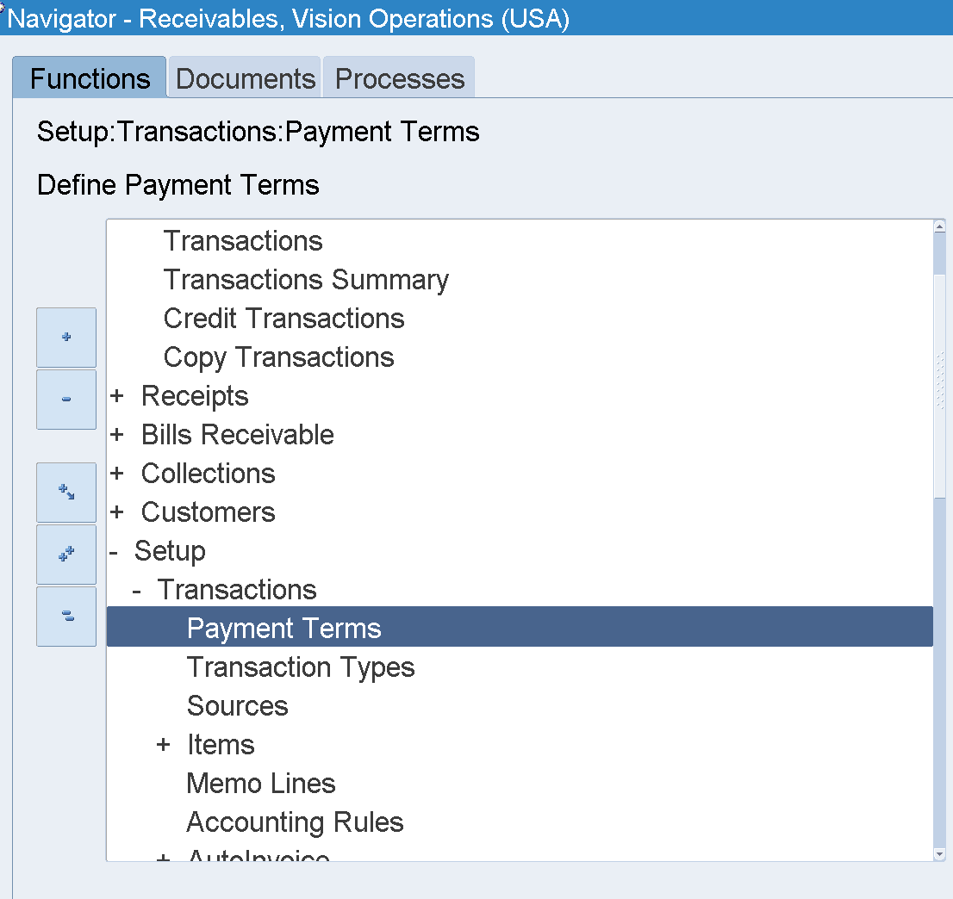
Payment Term
Payment Term: the conditions under which a customer is expected to pay for the goods or services they have purchased. It determines factors like the due date, any applicable discounts for early payment, and the penalty for late payments.
The payment terms are associated with customer invoices, and they help automate the calculation of due dates, discounts, and late fees within the AR module.
To access payment term within the Accounts Receivable(AR) module
Setup > Transactions > Payment Terms

Slide 13
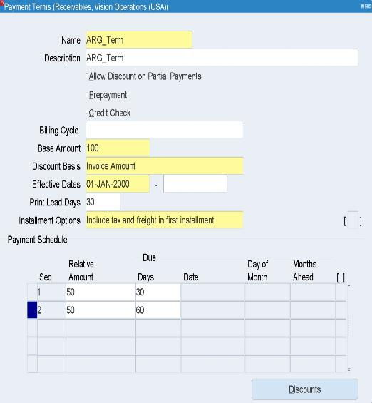
Payment Term
Base Amount : The principal amount on which payment terms are calculated.
Discount Base: whether the discount is calculated on the entire invoice amount or only part of it.
Invoice Amount (including tax and freight)This helps determine the accurate amount eligible for an early payment discount.
Effective Dates: Specifies the date range during which the payment term is valid.
Print Lead Days: Defines the number of days before the payment due date when a reminder or dunning letter is generated
Installment Options : Used when an invoice needs to be divided into multiple payments across different due dates.
Tax and Freight in First Installment : Determines whether the total tax and freight amounts are applied entirely in the first installment.
First Sequence (Seq)
Relative Amount: The first installment covers 50% of the total invoice amount.
This installment is due 30 days from the invoice date.
Second Sequence (Seq)
Relative Amount: The second installment covers the remaining 50% of the total invoice amount.
This installment is due 60 days from the invoice date.

Slide 14
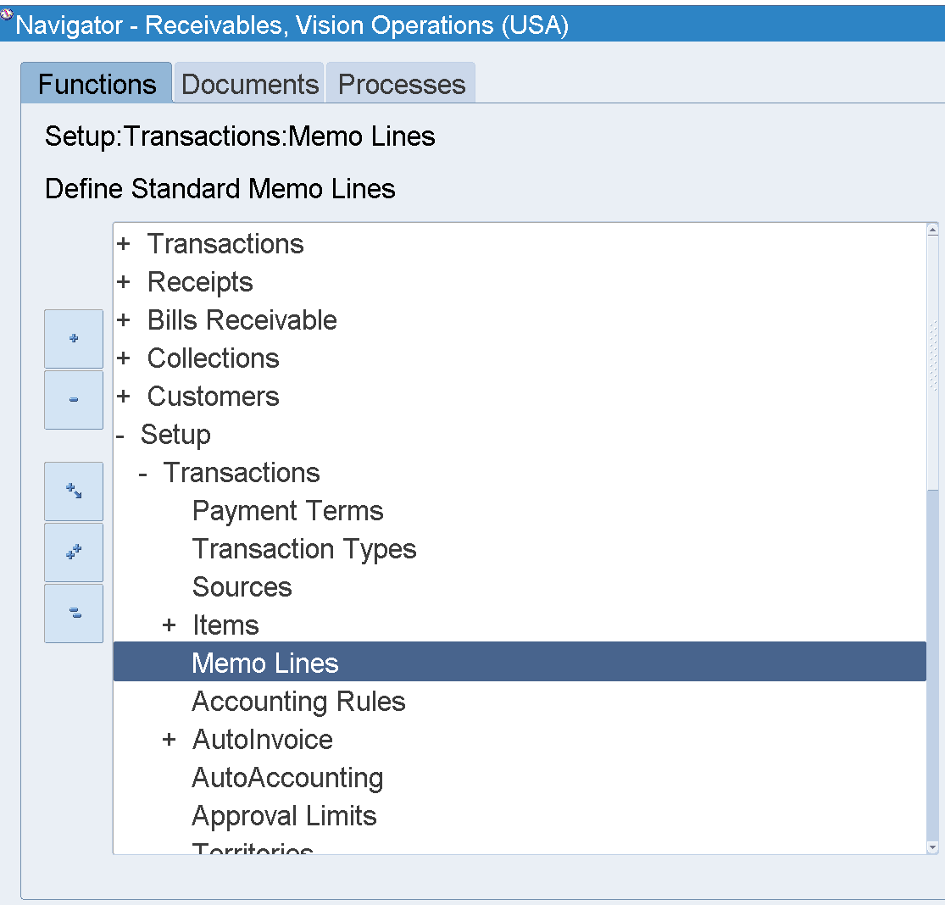
Memo Line
Memo Lines: are used to provide additional descriptive information about a transaction. They are essentially free-text fields that allow users to enter notes or comments related to an invoice, debit memo, credit memo, or other types of transactions.
Purpose
Memo Lines are used to add context or details to a transaction that may not be captured in other fields.
They can describe the nature of the transaction, provide internal notes, or include any other relevant information.
Usage
Memo Lines can be entered manually by users when creating transactions.
They can also be populated automatically using predefined templates or rules.
To access memo line within the Accounts Receivable(AR) module
Setup > Transactions > Items > Memo Line

Slide 15
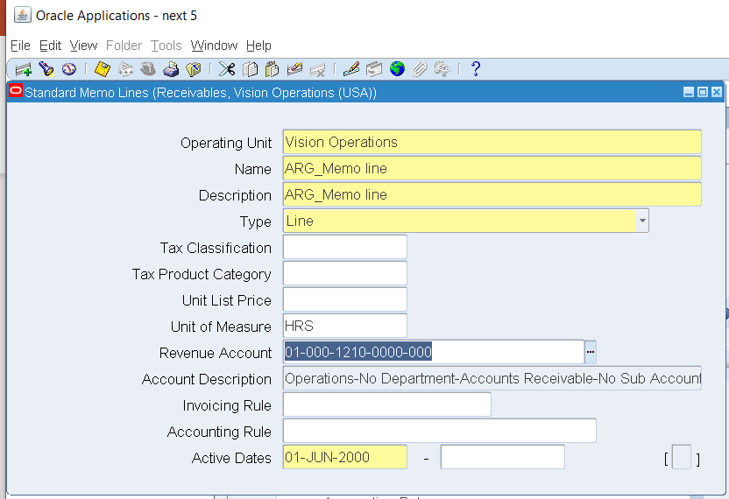
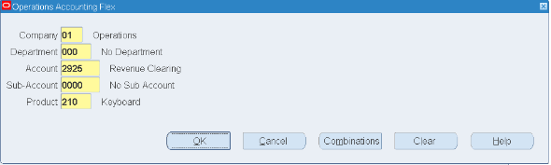
Memo Line
By using memo lines consistently, you can improve your ability to track and analyze transactions. this is especially helpful when reviewing historical data or researching discrepancies.
For example, if we need to identify a product “ keyboard” to apply a revenue on when we add a memo line in the invoice, we follow the following step:
Identify Name, and Description.
From “Revenue Account”, we identify the account type and the product we need.
Press Ok
Identify the Active date.
Save

Slide 16
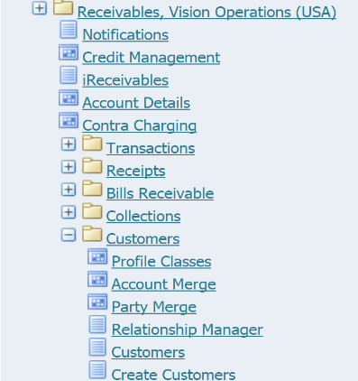
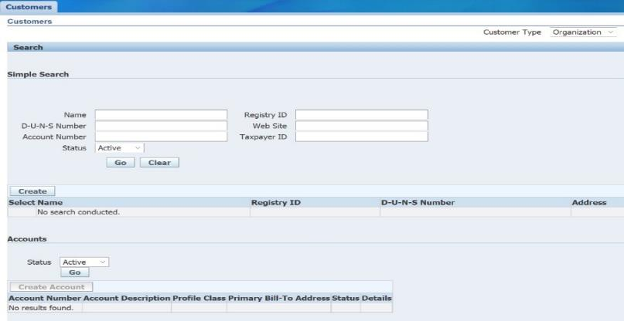
Create Customer
Customer: refers to an entity (either an individual or a company) to whom your business sells goods or services and from whom payments are expected.
To create customer within the Accounts Receivable(AR) module
Receivables, Vision Operations > Customers > Create Customers > Create

Slide 17
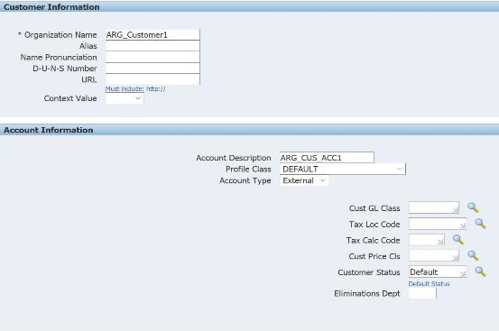
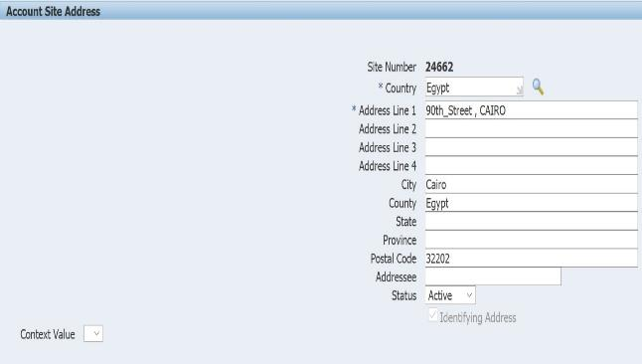
Create Customer
We entered the customer’s name and some of his related information.
We entered the account name, as each customer has at lest one account.
Then we entered his address.

Slide 18
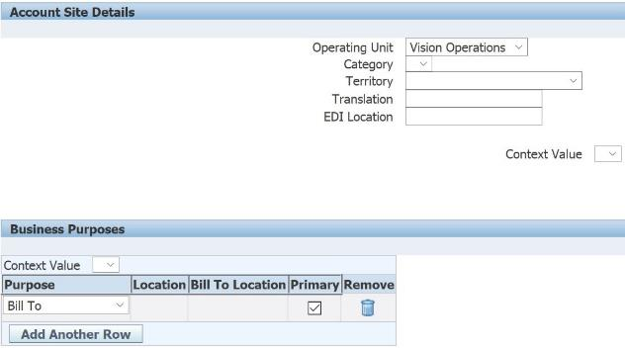
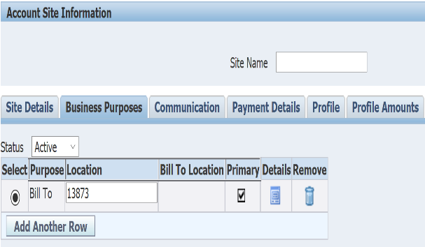
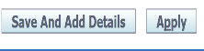
Create Customer
We entered our operating unit.
We select "Bill To," which is the address previously defined for the client and used for sending invoices.
We entered Save And Add Details.
We choose Business Purposes then Details.

Slide 19
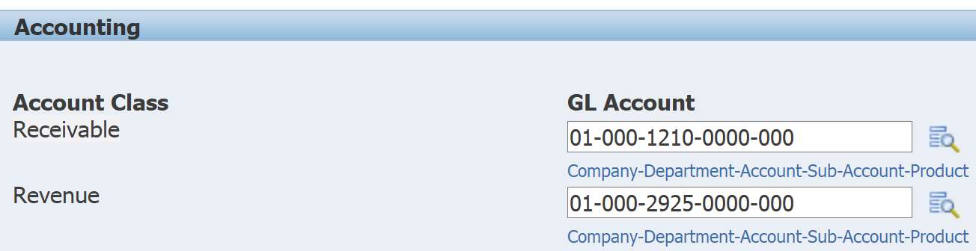
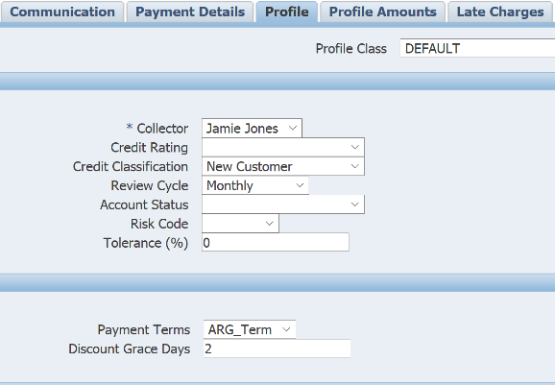

Create Customer
We enter the code combination for Receivable and Revenue then we choose Apply.
We choose Profile and We select the payment terms that we previously defined.
We choose Apply.

Slide 20
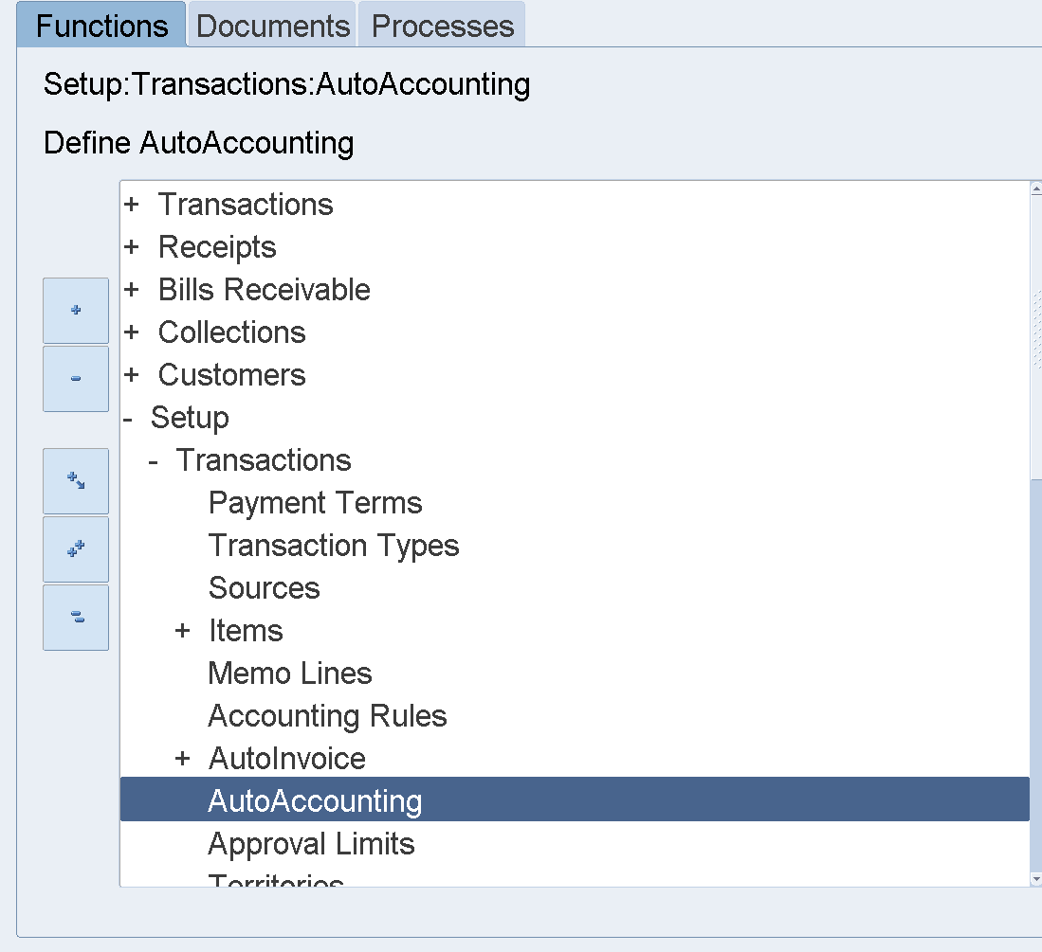
Auto-Accounting
Auto-Accounting: is a feature that automatically generates accounting distributions for transactions such as invoices, debit memos, and credit memos without manual intervention.
It ensures that accounting entries are consistent and accurate based on predefined rules set by the organization.
To access source within the Accounts Receivable(AR) module
Setup > Transactions > Auto-Accounting.

Slide 21
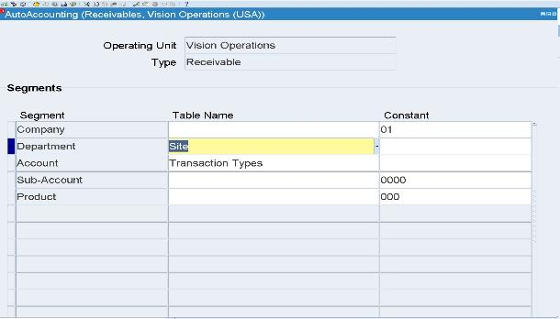
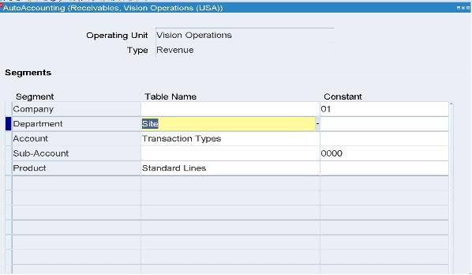
Auto-Accounting
By auto-accounting, we control the source of each segment value such as receivables and revenues.
It identifies the drive of the transactions such as invoices.

Slide 22
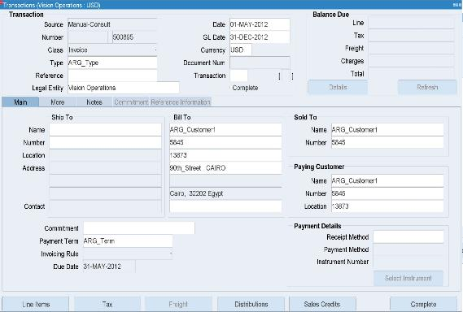
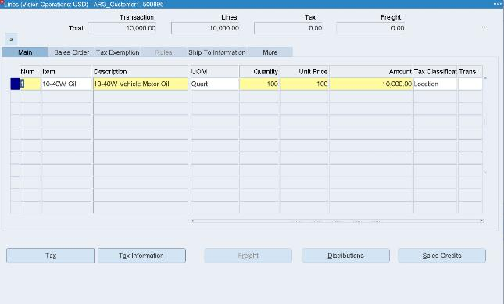
Transactions: Invoice
Choose (class) : Invoice.
Select the previously defined type and enter the date and Gl date.
Choose our customer from “Bill to”.
From Line Items we added the items then we saved and choose complete.

Slide 23
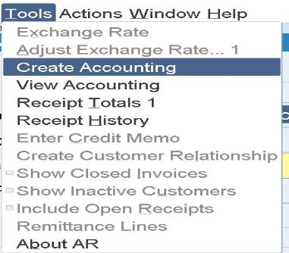
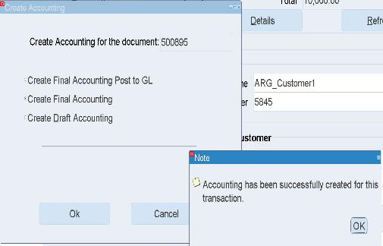
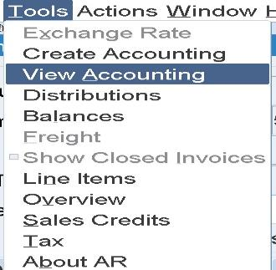
Transactions: Invoice
From Tools choose Create Accounting to Generate accounting entries, Transfer to general ledger, and Error Identifications.
From Tools choose View Accounting to show accounting entries.
we find Receivable in the Debit with the value of $10000 and Revenue in the Credit with a value of $10000.

Slide 24

Transactions: Memo Line
After we define the product in memo line, we start creating standard memo line transaction to notice and confirm the results.
Steps to be followed:
Transaction> transaction.
From class we choose invoice
.Start to choose customer and define other required data.
From line Items we add the items and memo line
as shown:

Slide 25
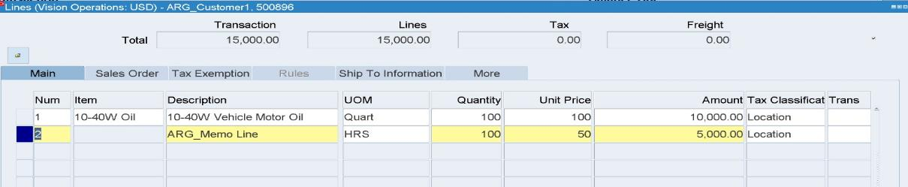
We notice that:
When we make view accounting to see the effects, we see that it traces the product " keyboard" as separate revenue account and charges it the amount of memo line we have added " 5000 ".

Slide 26
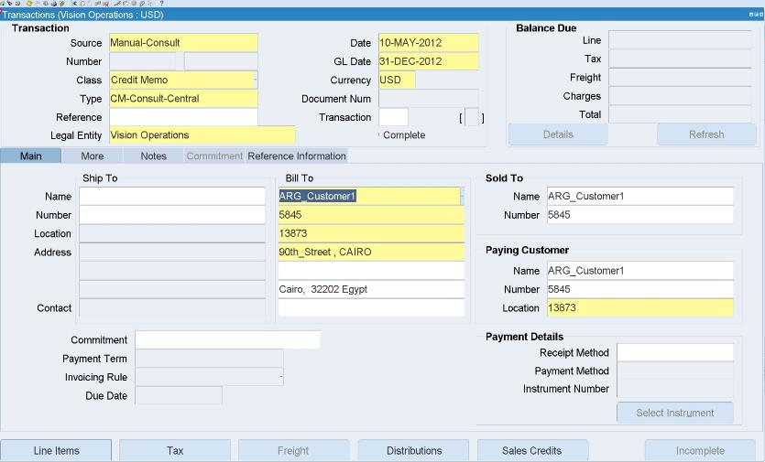
Transactions: Credit Memo
When we have a decrease in the customer obligations for the entity, we have to make a credit memo transaction.
Steps to be followed:
1- choose credit memo from class.
2- choose your customer and add the other required data.
3- From Line Items section we add the item with a negative amount.
As shown:

Slide 27
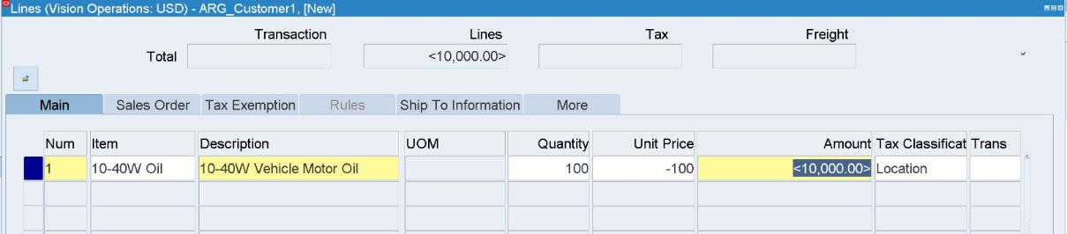
When we view accounting we notice that the receivables will be credited and the revenue will be debited by the amount we credit in the transaction.

Slide 28
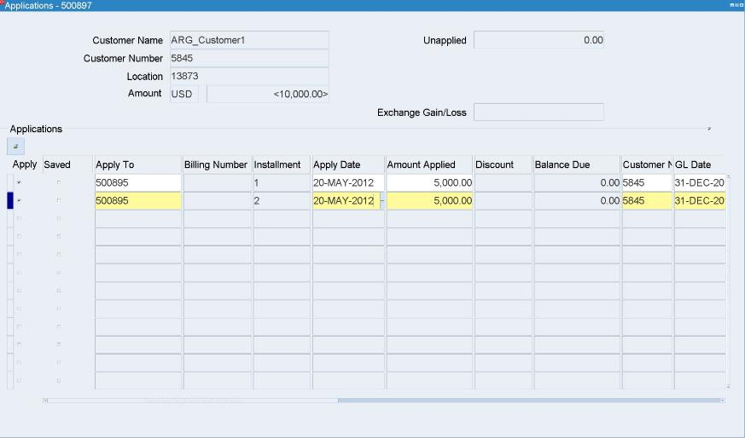
After we have credited the transaction we should make an application for to close its balance
Steps to be followed:
Action> Application
In " apply to" section we choose the transaction number needed.
In " apply date" section we set the required date.
Save your steps.

Slide 29
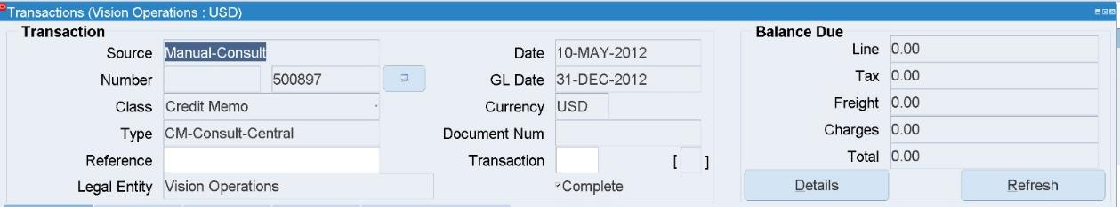
To confirm our steps, from Find Icon "🔦", we search for transaction number.
From " Balance Due" section, we enter to "Details".

Slide 30
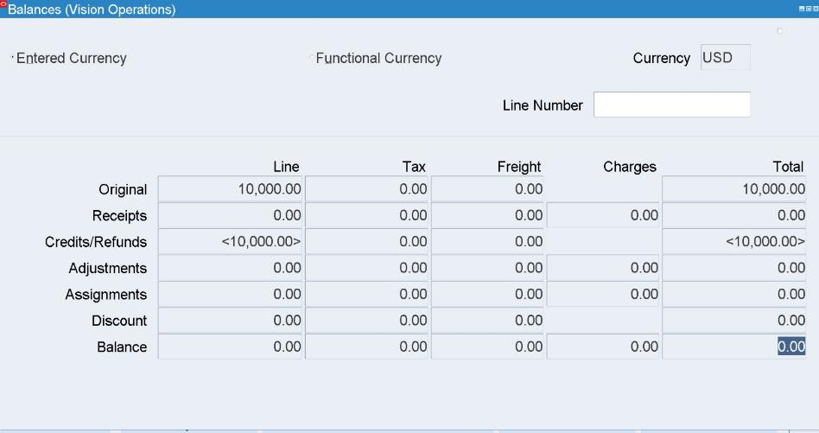
We notice that the transaction balance is zero and there is credit transaction has been applied.

Slide 31
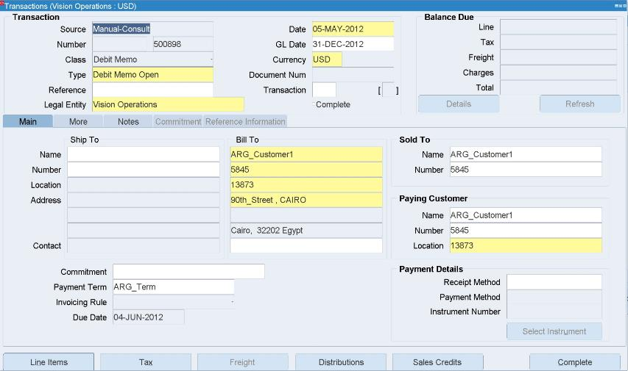
Transactions: Debit Memo
When we have an increase in the customer obligations for the entity, we have to make a debit memo transaction.
Steps to be followed:
1- choose debit memo from class.
2- choose your customer and add the other required data.
3- From Line Items section we add the item with the required amount.
As shown:

Slide 32
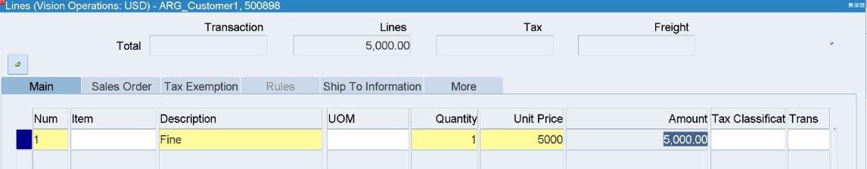
When we view accounting we notice that the receivables will be debited and the revenue will be credited by the amount we debit in the transaction.

Slide 33
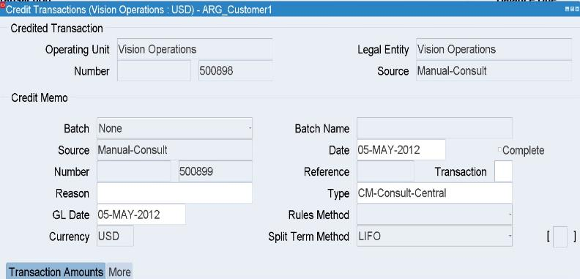
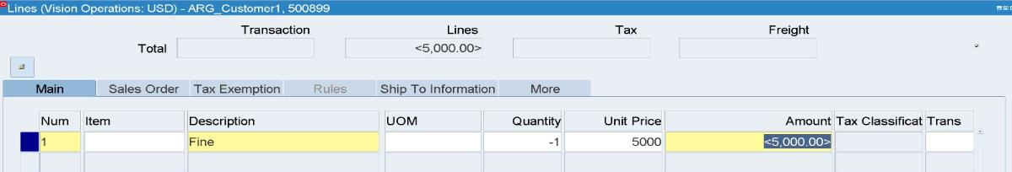
There is another way to credit an amount for a transaction. It is as followed:
Action> Credit
Set the data and the reason for credit.
Set the type of the credit memo and the split method ( FIFO, LIFO, Prorate).
From the " Credit Line" we set the credit amount in a negative sign.

Slide 34
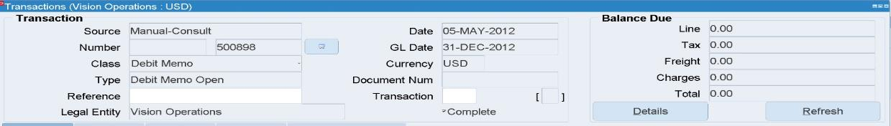
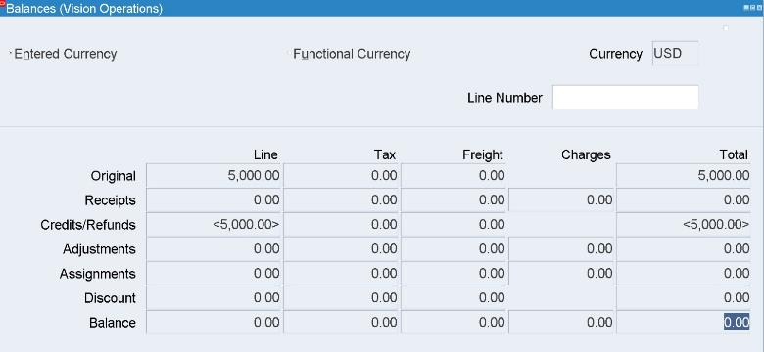
5- Close the credit screen then refresh the debit memo screen.
6- From " Details", you can notice that balance equals zero.

Slide 35
Transactions: Deposit
A deposit transaction represents a prepayment from a customer for goods or services they intend to purchase in the future. Think of it as a customer placing money "on account" before they actually make a purchase.
Here's the core idea:
Prepayment : The customer gives you money in advance.
Future Purchases : This money will be applied to future invoices when the customer buys something.
Commitment : It often signifies a commitment from the customer to do business with you.
NOTE:
- The key action is "applying" the deposit to the invoice. This links the prepayment to the actual sale.
- Oracle AR provides reports to track outstanding deposit balances.
The Typical Deposit Transaction Cycle:
1- Frist Stage
Create the Deposit : You enter a deposit transaction , recording the amount of the prepayment.
As followed:

Slide 36
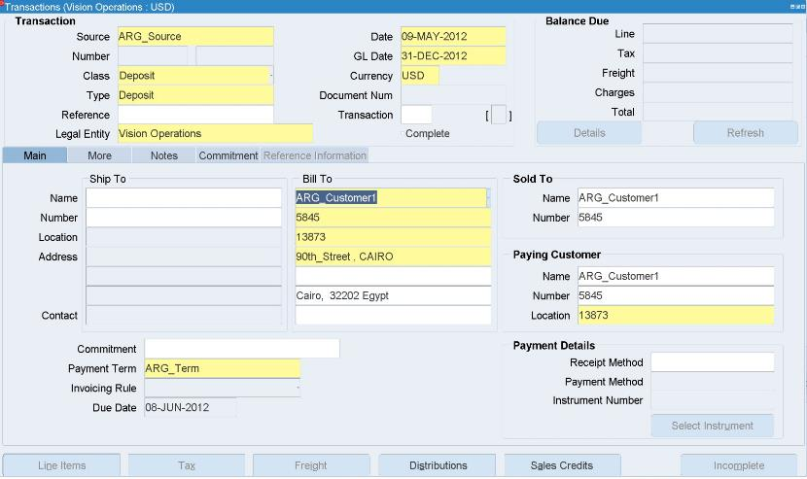
Transactions: Deposit
_ At first we determine the class " deposit" and define the type as " deposit.”
_ Second, we determine the date of the deposit.
_ Third, we determine the customer that gave us the money in advance.
Note that:
The line Items section is not active.
_ Fourth, click on commitment section.

Slide 37
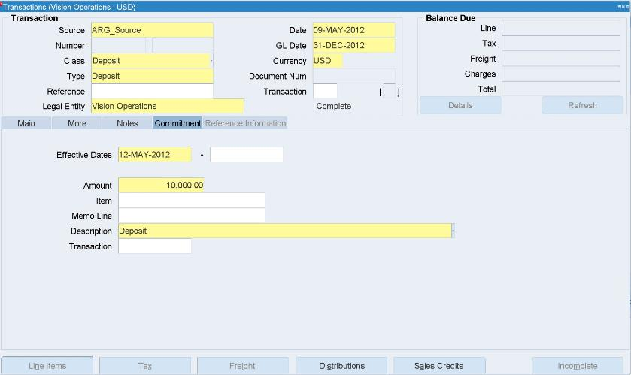
Transactions: Deposit
_ After that in the commitment section, we determine the effiective date, Amount the we had received, and identity the description " Deposit; by example".
_ Then we will save and press complete.
_ The final step in this stage to confirm our previous steps is:
Tools >> create accounting >> create final accounting
101

Slide 38
Transactions: Deposit
_ From: Tools>> view accounting, we note that;
Accounts receivables will be debit.
Accrual will be credit.

Slide 39
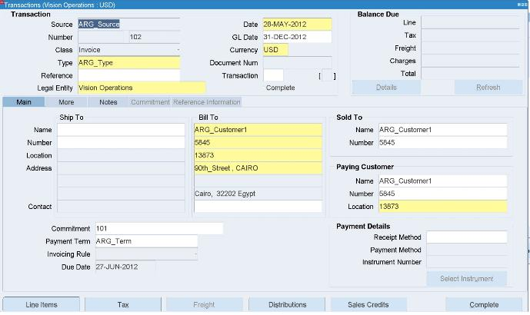
Transactions: Deposit
2- Second Stage:
Create the Invoice : When the customer makes a purchase, you create a standard invoice.
Apply the Deposit to the Invoice: You then apply the deposit to the invoice, reducing the amount the customer owes.
This essentially uses the prepayment to pay for
the current purchase.
As followed:
_ From class section , we choose “ Invoice” and from type section, we choose the transaction type.
_Then we choose the invoice data and determine the customer that has paid in advance.
we note that the commitment section will be active by the customer deposit transaction number.
_After that, we move to Line Items section.

Slide 40
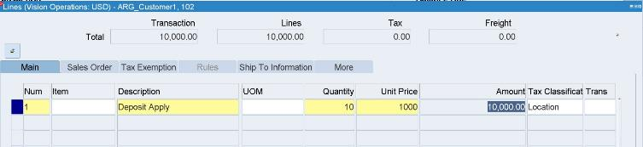
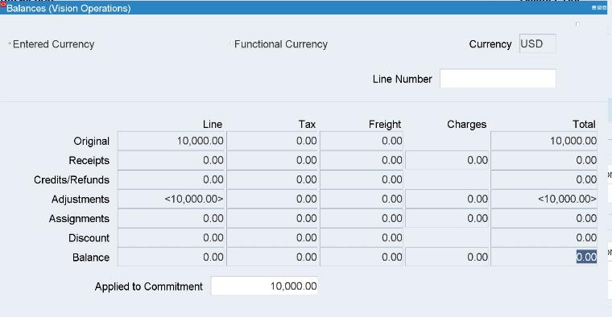
Transactions: Deposit
_ We enter the description, the quantity, and the unit price of the sale
Then we press complete and do the final accounting from:
Tools >> create accounting >> create final accounting
3- Third stage:
Reconciliation : The Oracle system then reconciles the deposit transaction, and the invoice transaction.
To confirm:
From Details section we will note the adjustments and that the final balance will equal zero

Slide 41
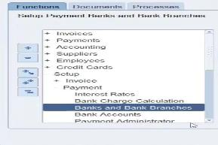
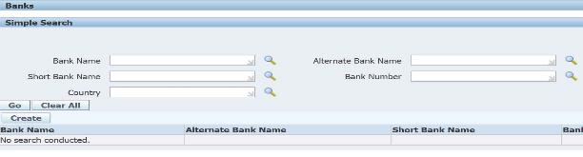
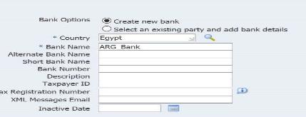
Create bank and bank branches
1-Bank: refers to an entity or financial institution that is used to process payments, receipts, and other financial transactions.
To create bank and bank branches within the Accounts payable (AP) module:
payables, vision operations > Setup > Payments > Banks and bank branches > create.
1- First, we entered the bank name:“ARG_Bank”.
2- then, We selected the country where the bank is located “Egypt” and save.

Slide 42
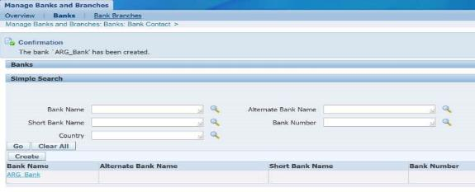
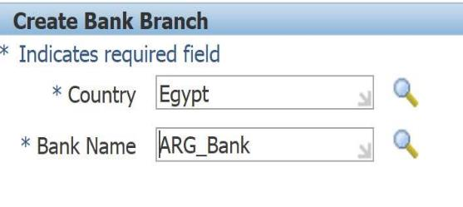

-Bank branches: refers to the physical locations or subdivisions of a bank.
1-After we created the bank we went to the Branches section and clicked on Create Branch then we selected the country and the bank name.
2-Next, we entered the branch details and save.

Slide 43


Create Bank Account
-Bank Account: refers to a financial account used for managing cash transactions like payments and receipts.
To create bank and bank branches within the Accounts payable (AP) module:
payables, vision operations > Setup > Payments > Bank Accounts > create.
1- First, we entered the Country name “Egypt”.
2-then we entered the bank name “ARG_Bank” and branch name “ARG_branch1”.
3-we selected the legal entity “vision operation” and account use “receivable”.

Slide 44




4-we entered Account name, Account Number and selected “Multiple currencies allow” to handle accounts that deal with more than one currency.
5-we selected cash account where all the company’s cash transactions are stored, whether payments or receipts.
6-we opened add organization access.
7- we selected the organization “vision operation” and account use “receivable”.

Slide 45

7-we selected GL Accounts :-
.Cash : This is the GL account where the bank's cash balance is recorded.
.Confirmed Receipts: Payments that have been applied to customer invoices and confirmed.
. Bank Charges: If there are any fees or charges associated with the bank account.
. Remitted Receipts: Payments sent to the bank but not yet cleared or confirmed.
. Unapplied Receipts: This is used to track unapplied or unallocated payments from customers.
. Unidentified Receipts: Payments with unclear or missing remittance details.
. On Account Receipts: Payments placed on a customer’s account without applying to a specific invoice.

Slide 46


8- we selected receivable activities :-
.Unearned Discounts Refers to discounts given to customers but not yet earned because the terms for earning the discount (such as early payment or a certain volume of purchases) haven’t been fully met.
.Earned Discounts: Refers to discounts that have been earned by the customer because they’ve met the conditions (e.g., early payment within a specified period).
. Claim Investigations: Refers to the process of investigating and resolving any disputes or claims made by customers, such as incorrect billing, damaged goods, or other issues.
9- we select apply then finish And in this way, we have created the bank account.

Slide 47

Receipt Method
Receipt Method: refers to the way in which a customer’s payment is received and processed.
To create receipt method:
Receivables > Setup > Receipts > Receipt classes.
1- Receipt class:-
. We enter Name, Creation method, Remittance method and clearance method.
2- Receipt method :-
. We entered name and effective date then select bank accounts.

Slide 48

3- we selected bank name and account name then all GL Accounts appeared automatically from the bank.

Slide 49



Create save box
Save Box : refers to the process of saving the information about a particular box in the system, such as amounts and dates, to keep track of balances and financial records for future reference or review.
The Save box is treated like a bank, so we will follow the same steps we used when creating the bank and its branches.

Slide 50




After that, we will create a bank account for the Save box:

Slide 51



-Here, we only need a cash account because it is money coming directly into the bank.
-After that we select apply then finish And in this way, we have created the bank account for save box.

Slide 52


Create a receipt for the Save box.
-To create receipt :
Receivables > Setup > Receipts > Receipt classes.
-then we entered receipt class and receipt method.
After that we selected bank account and selected bank name all the accounts will appear automatically.

Slide 53


Create receipt:
-we entered receipt method( the state will appear automatically) , receipt number, receipt amount and date.
-after that, we clicked on Save and Create Final Account. By doing this,
we will have created a receipt without a customer.

Slide 54


So we will have cash as debit and unidentified cash as credit because we didn’t entered the customer.
- After that we returned to the receipt, entered the customer clicked on Save and Create Final Account.

Slide 55


-after we entered the customer the entries turned into this form:
-to apply: we choose the receipt, amount applied and apply date then we clicked apply.

Slide 56

And the entries has turned into this:

Slide 57

Receipts
After we create Receipts Method , Now we can create receipts.
Steps to be Followed :
1- Choose my receipt method
2- Add Receipt Number
3- Add Receipt Amount
4- Enter Receipt Date and GL date
5- State will be confirmed and the Balance will be Unidentified
6- Press Save

Slide 58


From Tools choose Create Accounting to Generate accounting entries, Transfer to general ledger, and Error Identifications.
From Tools choose View Accounting to show accounting entries.
we find Confirmed Cash in the Debit with the value of $1000 and Unidentified Cash in the Credit with a value of $1000.

Slide 59

Now I will enter the Customer Name , then press save
We notice that :
the balance will change to Unapplied

Slide 60


From Tools choose Create Accounting to Generate accounting entries, Transfer to general ledger, and Error Identifications.
From Tools choose View Accounting to show accounting entries.
we find Unidentified Cash in the Debit with the value of $1000 and Unapplied Cash in the Credit with a value of $1000.

Slide 61


Select Apply , then in Apply to enter On Account and save it.
We notice that :
The balances will changes to On Account

Slide 62

From Tools choose Create Accounting to Generate accounting entries, Transfer to general ledger, and Error Identifications.
From Tools choose View Accounting to show accounting entries.
we find Unapplied Cash in the Debit with the value of $1000 and On Account Cash in the Credit with a value of $1000.

Slide 63


We will make an invoice to Apply the amount (1000 $) on account
1- choose Invoice from class.
2- choose your customer and add the other required data.
3- From Line Items section we add the item with the required amount)1000$).

Slide 64


Select Apply , then in apply to choose the invoice , but the invoice will appear in two amount (500 , 500) because the payment term , so I will make apply on the first amount of invoice (500$)
we notice that :
The balances will be 500$ Applied , the other 500$ will be Unapplied

Slide 65


I will apply the other amount of invoice( 500$ )
We notice that :
The balances will changes to Applied

Slide 66

From Tools choose Create Accounting to Generate accounting entries, Transfer to general ledger, and Error Identifications.
From Tools choose View Accounting to show accounting entries.
we find On Account Cash in the Debit with the value of $1000 and Receivables in the Credit with a value of $1000.

Slide 67

Remittance
It is a document that buyer sends to a seller conveying that an invoice is paid.
It is not mandatory but serves as proof of payment.
To access Remittance within the Accounts Receivable (AR) module:
Receipts > Remittance

Slide 68


Steps to be Followed :
1- Choose my receipt Method
2- Choose the bank
3- Enter to Manual create
4- Press ctrl+ f11 , the receipt will appear , then select it and press on Format

Slide 69


From Find Icon "🔦", we search for The receipt.
And we notice that : the state changed to remitted.
From tools choose create accounting , From tools choose view accounting
we find Remitted Cash in the Debit with the value of $1000 and Confirmed Cash in the Credit with a value of $1000.

Slide 70


We will make receipt , the state here is confirmed , We will change it to remitted as the previous slides.
The amount of receipt is (7500$)

Slide 71
From Tools choose Create Accounting to Generate accounting entries, Transfer to general ledger, and Error Identifications.
From Tools choose View Accounting to show accounting entries.
we find Remitted Cash in the Debit with the value of $7500 and Confirmed Cash in the Credit with a value of $7500.

Slide 72

Apply the amount (3000$) and the other I put them on account (4500)
The balances will be:
Applied = 3000$
On Account = 4500$
From Tools choose Create Accounting , then from Tools choose View Accounting.
we find Unapplied Cash in the Debit with the value of $3000 , On Account Cash in Debit with the value of 4500$ and Receivables in the Credit with a value of $7500.

Slide 73



To Cancel the Receipt
Steps to be Followed :
1- Press Apply , then unapply the receipts
2- From Tools choose Create Accounting
3- Press to reverse
4- Enter the date , choose the category and the reason then press reverse
We notice that : the state will changes to reversed
5- From Tools choose Create Accounting

Slide 74


From Tools choose View Accounting
We find Unapplied Cash in Debit and Remitted Cash in Credit

Slide 75


To make a Transaction with foreign currency
Steps to be Followed:
Firstly: We need to make a Conversion factor from USD To EUR.
• So, Go to: General ledger, then choose:
Setup > Currencies > Rates > Daily.
- We’ll find the Daily rates was opened.
1- Choose the currencies used in Conversion.
2- The date of the exchange rate.
3- The exchange rate Type.
4- The USD to EUR conversion rate.
5- The EUR to USD conversion rate.

Slide 76


The Transaction
6- Return to Receivables to make the transaction
7- Enter the date and currency ( we will choose Euro )
8- From Bill to add the customer
9- From Line Items section we add the item , Quantity and price , then press save

Slide 77


10- Press Complete
11- From Tools choose Create Accounting to Generate accounting entries, Transfer to general ledger, and Error Identifications.
12- From Tools choose View Accounting to show accounting entries.

Slide 78


Receivable Activities
To access Receivable Activities within the Accounts Receivable (AR) module:
Setup >> Receipts >> Receivables Activities.
Enter Operating unit .
Named it Then Chose the Type: Adjustment.
GL Account Source: we will choose Activity GL Account.
Then , we will choose an account in Activity GL Account , then press save.

Slide 79


Approval Limits
To access Approval Limit within the Accounts Receivable (AR) module:
Setup>>Transactions>>Approval Limits.
Press on F11.
The We’ll write in User Name: OPERATIONS Then the Currency.
We put the limit 5000.
- Then SAVE.

Slide 80

Make an Adjustment
• After we make an Approval Limits, We go back to the Transaction.
Steps to be followed:
1- We go to: Actions>> Adjust.
2- Press Adjust , then choose the Activity Name
3- On Type we will choose line
4- On Amount we will decrease the amount to (-100) , then enter the Date and press Save.

Slide 81



Make an Adjustment
5- From Actions > Adjust > adjust >
6- To make create accounting we go to the line screen and we press on:
Tools > Create accounting> Create final accounting

Slide 82


The balance after Adjustment
If we press refresh , we will notice that : the balance decrease to 900
- Press Details , we will find the original amount , the adjustments and the balance

Slide 83
The Adjustment Entries
From Tools we select View Accounting
We notice that:
Adjustment is debited
Receivables is credited

Slide 84


Make A Refund
• Steps to make A Refund:
1- Go to Setup >> Receipts >> Receivables Activities.
2- Enter the operating unit and name , in Type choose Refund
3- In Activity GL Account enter the account .
4- Press SAVE.
5- Make an approval limit.

Slide 85


Making An Apply for The Transactions
5- Return to Receipts
6- Enter to apply , then unapply , press save
7- Enter to apply , on apply to choose refund
8- Enter the date ,the amount

Slide 86


Refund Attributes
9- Enter to Refund Attributes
10- We mention Our Customer by: Name Or Number.
11- Then choose The Refund Payment Method: Electronic.
12-Then Press: Apply, SAVE.
13- From tools choose Create accounting
14- From tools , view accounting
We will find : Refund in Credit and Receivable in Debit

Slide 87


Refund
15- Switch Responsibility to (Payables, Vision Operations (USA)
16- From :Invoices >> Entry >> Invoices.
17- In Type We chose Payment Request, then press find.
18- From Actions > Create accounting > Final > Ok > Actions > Pay in Full > Ok

Slide 88


Pay In Full
19- Enter the Payment date , address , Bank account , then press save
20- From Actions > Create Accounting > Final > Ok

Slide 89



21- From View Payments, then Payment Overview > Payments
22- From Tools > View Accounting
We will find the Transactions , Item Expenses in Debit and Liability in Credit

Slide 90

The write off
• Steps to make A Write Off:
1- Go to Setup >> Receipts >> Receivables Activities.
2- Enter the operating unit and name , in Type choose Receipt Write-off
3- In Activity GL Account enter the account .
4- Press SAVE.
5- Make an approval limit.

Slide 91


Making A Receipt
Steps to be followed :
1- Choose my receipt method
2- Add Receipt Number
3- Add Receipt Amount
4- Enter Receipt Date and GL date
5- Add the Customer
6- Press Save , then enter to apply
7- In apply to we will choose Receipt Write-off

Slide 92



8- Enter the Date and Activity
9- Press Save
10- From Tools choose Create Accounting
11- From Tools Choose View Accounting
We will find : Cash in Debit and Write off in Credit

Slide 93



Requests
Reports : Reports in Oracle AR are tools that extract specific financial data, such as invoices, payments, and customer accounts, to help you track receivables, manage finances, and make informed decisions.
Steps to Run a Report in Oracle Accounts Receivable (AR):
Open the Requests Window:
From the top menu > View > Requests
Create a New Request:
Submit a New Request > Single Request or Request Set > OK

Slide 94



Create Accounting Request
Open new window submit Request
Select Name (Create Accounting) > Press Enter
To Open New Window Parameters
>Select Ledger (Vision Operations (USA)) > Set End Date (31-DEC-2012) Set Report Summary to Detail > Click OK
We go back to window submit Request > Click submit
Show Decision Message
The system confirms that the request has been successfully submitted and provides a Request ID (5951236)
Submit another request
Click No to Check the request status (Pending, Running, Completed, or Error).

Slide 95


Check the request status
Open new window Requests
Find Request ID 5951236 > Create Refresh Data > Wait for Phase to change from Running to Completed.
Click Submit a New Request

Slide 96



Create Transfer Journal Entries to GL Request
Open new window submit Request
Select Name (Transfer Journal Entries to GL)
> Press Enter
To Open New Window Parameters
>Select Ledger (Vision Operations (USA)) > Set End Date (31-DEC-2012) > Click OK
We go back to window submit Request > Click submit
Open new window Requests
Find Request ID 5951251 > Create Refresh Data > Wait for Phase to change from Running to Completed.
Click Submit a New Request

Slide 97



Unposted Items Report Request
Open new window submit Request
Select Name (Unposted Items Report)
> Press Enter
To Open New Window Parameters
>Select Ledger Currency (USD)
> Set Start GL Date (e.g., 01-MAY-2012)
>Set End GL Date (e.g., 31-MAY-2012) >
Click OK
We go back to window submit Request > Click submit
Open new window Requests
Find Request ID 5951251 > Create Refresh Data > Wait for Phase to change from Running to Completed.
Click View Output
View Output : is a tool to view report results after completion

Slide 98

View Output Report Name Unposted Items Report
Report Name: Unposted Items Report
This report provides a list of transactions that have not been posted to the General Ledger (GL) within the specified date range

Slide 99


Steps: From switch Responsibility
Set General Ledger, IFRS Reporting Vision
Journals > Enter >Find Journals > Choose source (Receivables) > Set Period
(From 01-MAY-2012 to 31-DEC-2012) > Click Find
Open new window Enter Journals (IAS Reporting Vision Ops)
Review or modify the journals (e.g., Review Journal or Post) > Click Post to post the journals if ready

Slide 100


From the top menu > View > Requests > find
Open new window Requests
Find Request ID 5951268 > Create Refresh Data > Wait for Phase to change from Running to Completed.
next post the journals

Slide 101




Steps: From switch Responsibility
Set Receivables, Vision Operations (USA) > control > accounting > open/close periods > change Status num 5 > from open> Show new window Period Statuses > We choose Close > Click Ok
We go back to window open/close periods
Enter Save

Slide 102



Transaction Register Request
From the top menu > View > Requests
>Create a New Request
> Single Request or Request Set > OK
Select Name (Transaction Register)
> Press Enter
To Open New Window Parameters
> Set GL Date From 01-MAY-2012)
>Set GL Date To (30-MAY-2012) >
Click OK
We go back to window submit Request > Click submit
Open new window Requests
Find Request ID 5951296 > Create Refresh Data > Wait for Phase to change from Running to Completed.
Click Submit a New Request

Slide 103



Receipt Register Report
Open new window submit Request
Select Name (Receipt Register)
> Press Enter
To Open New Window Parameters
>Select Ledger Currency (USD)
> Set GL Date From (01-MAY-2012)
>Set GL Date To (30-MAY-2012) >
Click OK
We go back to window submit Request > Click submit
Open new window Requests
Find Request ID 5951297 > Create Refresh Data > Wait for Phase to change from Running to Completed.
Click View Output

Slide 104

Receipt Register Report
Report: Receipt Register for Vision Operations (USA).
Currency: USD.
Date Range: 01-MAY-12 to 30-MAY-12.
Details: Lists receipts (e.g., customer, amount, date) for Company: 01.
Total: 21,500.00 (sum of all receipts).

Slide 105


Aging Buckets
Receivables > Setup > Collections > Aging Buckets and Interest Tiers
This screen defines Aging Buckets in Oracle Receivables. Aging buckets categorize outstanding receivables based on the number of overdue days.
Name: ARG_Aging
Type: 7-Bucket Aging (indicating seven time ranges)
Status: Active
Each row represents a time period that classifies invoices:
Current: (-∞ to 0 days) – Not overdue.
1-30 days: Past due by 1 to 30 days.
31-60 days: Past due by 31 to 60 days.
61-90 days: Past due by 61 to 90 days.
91-180 days: Past due by 91 to 180 days.
181-365 days: Past due by 181 to 365 days.
Overdue: More than 366 days overdue.
This setup helps in aging reports and collection follow-ups.

Slide 106



From the top menu > View > Requests
>Create a New Request
> Single Request or Request Set > OK
Select Name (Aging - 7 Buckets Report)
> Press Enter
To Open New Window Parameters
> Set Order By: Customer >Set Report Summary: Invoice Summary > Set Report Format: Detailed > Set As Of Date: The report runs up to May 1, 2013 > Set Bucket Name: ARG_Aging (the defined aging bucket setup)
Click OK
We go back to window submit Request > Click submit
Open new window Requests
Find Request ID 5951313 > Create Refresh Data > Wait for Phase to change from Running to Completed.
Click View Output

Slide 107

Explanation of the Aging - 7 Buckets Report
Explanation of the Aging - 7 Buckets Report (View Output Request)
This report provides an aging analysis of accounts receivable balances. It categorizes outstanding invoices based on how long they have been overdue.
Key Sections of the Report:
Customer Details
Customer Name: ARG_Customer1
Customer Number: 5845
Location: Cairo
Invoice Details
Lists various transactions with their types, dates, and amounts, including:
Deposits
Guarantees
ARG_Type invoices
Consulting invoices
Outstanding Amounts
Total Due: $28,350.00
Breakdown by Aging Buckets:
Current (Not Due): $0.00
1-30 Days: $0.00
31-60 Days: $0.00
61-90 Days: $0.00
91-180 Days: $0.00
181-365 Days: $28,350.00 (100% of the balance is overdue for more than 6 months)
Over 365 Days: $0.00

Slide 108
Clearing
Manual clearing involves the direct, user-driven matching of transactions, such as receipts and payments, against bank statements or other records. This contrasts with automated clearing, where the system performs the matching based on predefined rules.
When focusing specifically on the Accounts Receivable (AR) manual clearing process within an Oracle system, it's important to understand that it addresses situations where automated clearing isn't sufficient.
Key aspects of AR Manual Clearing in Oracle:
1- Identifying Discrepancies:
Manual clearing is often triggered when there are discrepancies between recorded receipts and actual bank deposits. This could involve:
- Differences in amounts.
- Missing or incorrect customer information.
- Unusual or complex payment scenarios.
2- Manual Matching:
The core of manual clearing involves manually matching receipts recorded in Oracle AR with corresponding entries on bank statements. This requires:
- Careful review of transaction details.
- Verification of customer accounts.
- Accurate identification of the correct invoices.

Slide 109
3- Applying Receipts:
Once a match is confirmed, the user manually applies the receipt to the appropriate customer account and invoice(s) within Oracle AR. This involves:
Updating the transaction status.
Recording the clearing date.
Ensuring accurate posting to the general ledger.
4- Handling Exceptions:
Manual clearing is essential for handling exceptions such as:
Short payments: Where the customer pays less than the invoice amount.
Overpayments: Where the customer pays more than the invoice amount.
Disputed invoices: Where the customer contests the validity of an invoice.

Slide 110

This is a scenario to explain manual clearing process that is related to accounts receivables:
1- we start with creating a receipt:
Receipt>> Receipt.
We set Receipt Method as ARG_ Remittance and the receipt number.
We determine the Receipt Amount as 4000 USD.
Set the receipt date.
We determine the Remittance Bank that will receive the cash.
We determine our customer to link the receipt.
Press apply
After that we create accounting by:
Tools>> create accounting>> create final accounting
Note: The receipt state will be confirmed and it is not recognized by cash management

Slide 111


2- We convert the confirmed receipt to remitted one.
Receipt>> Remittance.
Set the date and the receipt method.
Choose the Remittance Bank.
Press " Manual Create ”.

Slide 112



After that we press control+ F11.
All data receipts of the customer will appear.
We choose the receipt we need then Format.
Yes>> Ok

Slide 113




4- View the request.
View>> Request>> Find
We refresh data and wait for finishing

Slide 114


5- Remitted Receipt
From the icon 🔦 we search our receipt.
Then press find.
We choose needed receipt the open it .
Press apply
Note: The receipt state is remitted then it can be recognized in cash management.

Slide 115


Tools>> create accounting>> create final accounting
From Tools>> View accounting
We note that:
- Receivables account is credit.
- Remitted cash is debit.

Slide 116



6- cleared receipt:
We find cash> cash management, vision operations USA> clear transactions.
Choose AR receipts the find.

Slide 117


Choose the receipt then press open.
We note that the receipt state is cleared

Slide 118


Tools > create accounting > create final accounting.
From Tools > View accounting.
We note that:
Cash is debit.
Remitted cash is credit.

Slide 119



General Ledger
We will make journals
Steps to be Followed :
1- Enter to Journals > Enter
2- Choose new journals
3- Enter the period , effective date , ledger and select the category
4- On the lines , enter the transactions

Slide 120



5- post the journal
6-The request will run
7-The status will change to posted

Slide 121




Make another journal but we post it from different way
1-From journals > post
2- Search for the journal , then find , and post

Slide 122



The request will run and status will change to posted

Slide 123


To Cancel the Journals
There are two ways to reverse the journal
1- Switch Dr / Cr
2- Change sign
Here we will choose Switch Dr/Cr
Steps to be followed:
1- Select the Method
2- Enter reverse
3- The request will run and the lines will change

Slide 124


We will choose Change Sign
we notice that :
The status will change to reversed

Slide 125


Auto copy Batch
1- Enter the batch name and the period ,then ok
2- The request will run ,then post the journal
We notice that :
The source will change to AutoCopy

Slide 126


Recurring
To access Recurring within the General Ledger (GL) module:
Journals > Define > Recurring
Steps to be followed:
1- Enter the batch name , journal , ledger , category and currency
2- Enter to lines

Slide 127


3- Enter the line 1 , select the account
4- Enter the amount of line 1
5- Enter the line 2 , select the account
6- Enter the amount of line 2 but, put it in a negative sign

Slide 128


7- Enter Generate, Then submit

Slide 129


8- The request will run

Slide 130


9- Post the journal

Slide 131


